Slide 1


SAP OData Training
Day - 1.

Slide 2


Introduction
Anubhav Oberoy &
Shubham Singh
Trainer : Anubhav Oberoy & Shubham Singh

Slide 3

Agenda Day - 1
Introduction to OData
Why we need OData
Benefits of OData
What is REST ?
OData Calls – GET Sample SAP OData
Stateless v/s Stateful Communication
Break
What is Architecture of SAP Gateway – Embedded v/s Central HUB
How to Enable Gateway
What is RFC
Define System Alias
Important TCode’s
Trainer : Anubhav Oberoy & Shubham Singh

Slide 4
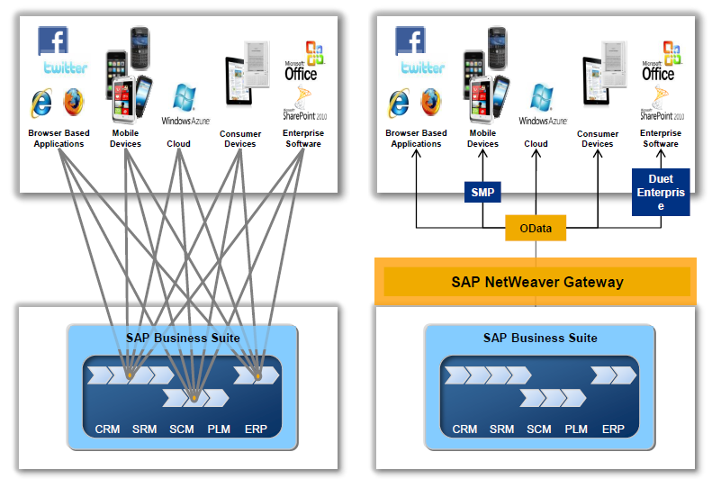
Introduction to OData
OData is open data protocol, it is used to create REST based services, initially developed by the OASIS (Organization for the Advancement of Structured Information Standards) company later acquired by Microsoft and make open source.
The simplest definition of OData would be that it is a standardized protocol built over existing HTTP and REST protocols supporting CRUD (Create, Read, Update, Delete) operations for creating and consuming data APIs.
Currently OData is widely used for exposing data.
Introduction
01
Software Innovation
02
Hardware Innovation
Trainer : Anubhav Oberoy & Shubham Singh

Slide 5
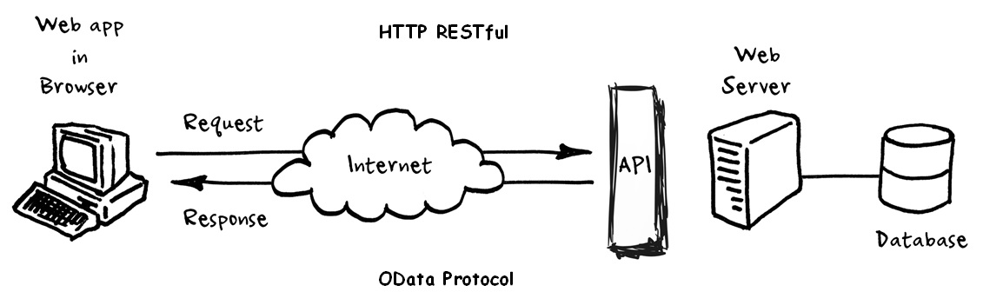
Why we need OData
OData helps you focus on your business logic while building RESTful APIs without having to worry about the various approaches to define request and response headers, status codes, HTTP methods, URL conventions, media types, payload formats, query options, etc.
OData (Open Data Protocol) is an ISO/IEC approved, OASIS standard that defines a set of best practices for building and consuming RESTful APIs.
OData also provides guidance for tracking changes, defining functions/actions for reusable procedures, and sending asynchronous/batch requests.
OData RESTful APIs are easy to consume. The OData metadata, a machine-readable description of the data model of the APIs, enables the creation of powerful generic client proxies and tools.
Introduction
01
02
Hardware Innovation
Trainer : Anubhav Oberoy & Shubham Singh

Slide 6
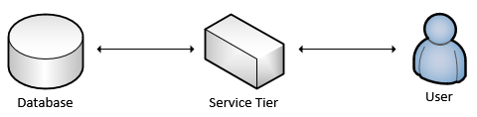
Benefits of OData
OData is able to provide metadata about your service interface that can be used to generate client code to access the service. So if you have lots of client classes that you need to create, this could speed up your process.
It lets developers interact with data by using RESTful web services.
It provides a simple and uniform way to share data in a discoverable manner.
It enables broad integration across products.
It enables integration by using the HTTP protocol stack.
01
Software Innovation
02
Hardware Innovation
Trainer : Anubhav Oberoy & Shubham Singh

Slide 7
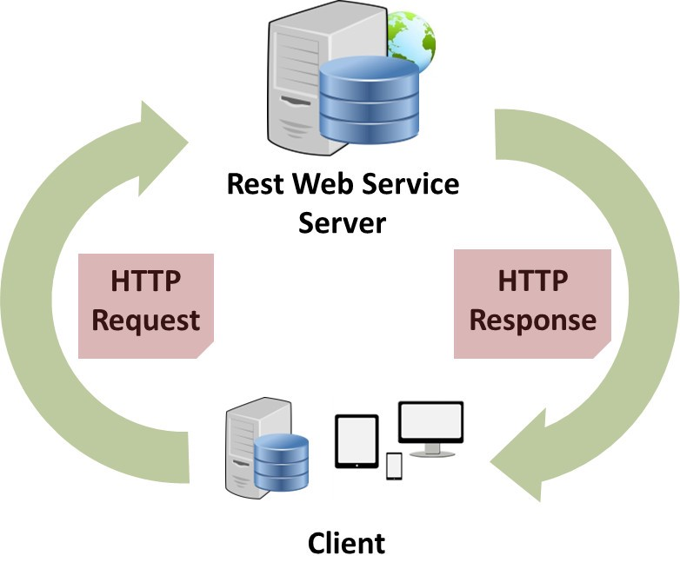
What is Rest?
A REST API (also known as RESTful API) is an application programming interface (API or web API) that conforms to the constraints of REST architectural style and allows for interaction with RESTful web services. REST stands for representational state transfer and was created by computer scientist Roy Fielding.
REST is defined as an option for web services and Remote Procedure calls. It is used for designing network applications.
REST services like a web services and supports below features −
Work with firewalls
Language-independent
Standards-based
Not Platform dependent
Code on Demand
Introduction
01
02
Trainer : Anubhav Oberoy & Shubham Singh

Slide 8
OData Calls – Get Sample OData
Sample OData Service
https://services.odata.org/V2/Northwind/Northwind.svc/?$format=json
Sets the page size of results.
02
$top
Indexes into a result set. Also used by some APIs to implement paging and can be used together with $top to manually page results.
Returns the results in the specified media format.
01
03
$format
$skip
ODATA Query
01
06
04
Filters properties (columns).
Retrieves related resources.
$select
$expand
05
$filter
Filters results (rows).
Trainer : Anubhav Oberoy & Shubham Singh

Slide 9
Stateless Communication
Stateful Communication
Server request based on information with
Each request.
Based on internet protocol which requires a tight state.
Introduction
Does not rely on the earlier request information.
Requests based on the information relayed with each request.
Deferent Servers can different information at Once.
Same server must be used to process all request.
01
Server does not hold request information
Information Stored from earlier request.
Trainer : Anubhav Oberoy & Shubham Singh

Slide 10
Break

Slide 11
Architecture of SAP Gateway
Central HUB Scenario Embedded Scenario
Presentation Layer
SAPGUI/Browser
Presentation Layer
SAPGUI/Browser
Fiori Apps
[new]Fiori Frontend Server
Like a HUB/Switch
services
Embedded System (LOCAL)
Services, Reg.,Publish, Fiori Apps, Launchpad, Designer, Apps, Code, ABAP Code
OData services publish
Introduction
Fiori launchpad
RFC(SM59)
Existing ECC/App Layer
Fiori Backend Server
SAP CRM
SAP PLM
Development of service code
01
SAP HCM
SAP SRM
HANA DB
02
HANA DB
Trainer : Anubhav Oberoy & Shubham Singh

Slide 12
Installation of ADT
01
Go to link
02
Install Java = java –version to check if its already there Java 8: SAP JVM 8 , Java 11: SapMachine 11
03
VS Runtime - For Windows OS: Microsoft Visual C++ 2013 (x64)
Steps for
Installation of ADT ………..ABAP Development Tool
04
Get an installation of Eclipse 2021-06
(e.g. Eclipse IDE for Java Developers)
05
In Eclipse, choose in the menu bar Help > Install New Software...
06
Enter the URL
https://tools.hana.ondemand.com/latest
01
Software Innovation
07
Select ABAP Development Tools and choose Next.
08
On the next wizard page, you get an overview
of the features to be installed. Choose Next.
02
09
Confirm the license agreements and
choose Finish to start the installation.
Trainer : Anubhav Oberoy & Shubham Singh

Slide 13
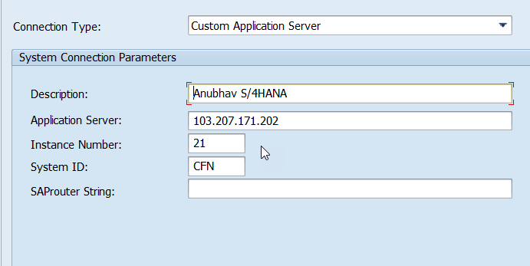
Server Access
User:- suser1 to suser20
Password:- welcome@123
01
02
Hardware Innovation
Trainer : Anubhav Oberoy & Shubham Singh

Slide 14
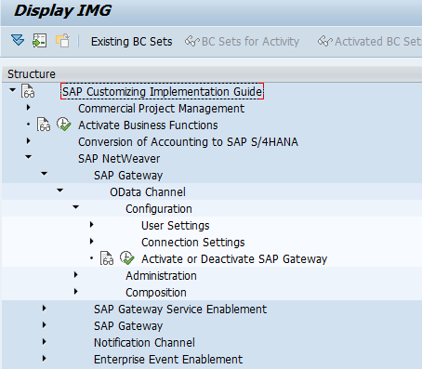
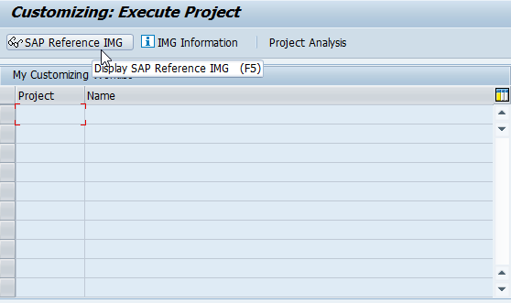
Steps for Enable SAP Gateway
Go to SPRO >> SAP Reference IMG.
Expand SAP NetWeaver >> Gateway >> ODATA Channel >> Configuration >> Activate or Deactivate SAP NetWeaver Gateway.
Click on Activate or Deactivate button to activate or deactivate SAP NetWeaver Gateway. In this case gateway is already activated.
01
Software Innovation
02
Hardware Innovation
Trainer : Anubhav Oberoy & Shubham Singh

Slide 15
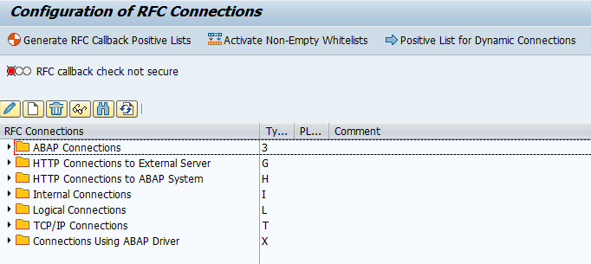
What is RFC
RFC is a mechanism that allows business applications to communicate and exchange information
(in pre-defined formats) with other systems. RFC stands for ‘Remote Function Call’
Tcode – “SM59”
RFC consists of two interfaces:
A calling interface for ABAP Programs
A calling interface for Non-SAP programs.
01
02
Trainer : Anubhav Oberoy & Shubham Singh

Slide 16
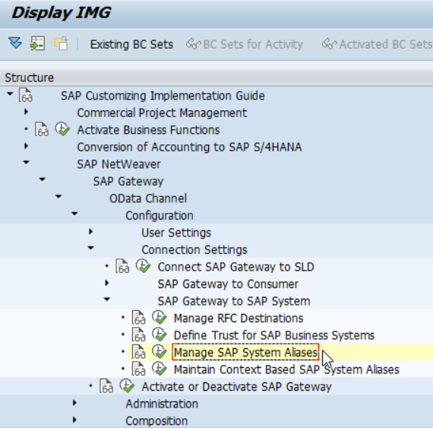
Define System Alias
Aliases are names that system administrators define for each system they create so that portal components can reference these systems. They are a means of retrieving the information stored on database servers without having to know the name of the server.
Procedure:
Use transaction SPRO
>>> SAP Reference IMG SAP Customizing Imp Guide
>>> SAP NetWeaver
>>> Gateway OData Channel
>>> Configuration
>>> Connection Settings
>>> Manage SAP System Aliases to OData Service.
Choose New Entries and enter the following:
Click Save to save your configuration settings.
01
Trainer : Anubhav Oberoy & Shubham Singh

Slide 17

Important TCode's
SEGW – Service Builder
/N/IWFND/MAINT_SERVICE – Maint Service / Registration of services
/N/IWFND/ERROR_LOG – Error logs of service calls
/N/IWFND/GW_CLIENT – Client Gateway / Test services locally within sap system
/N/IWFND/CACHE_CLEANUP - Cache Cleanup
02
Trainer : Anubhav Oberoy & Shubham Singh

Slide 18

Summarize
End of Day 1

Slide 19

Questions
Trainer : Anubhav Oberoy & Shubham Singh

Slide 20

ANUBHAV OBEROY
www.anubhavtrainings.com
THANK YOU
“You can never leave footprints that last if you are always walking on tiptoe.”
Notes:
https://pixabay.com/photos/men-employees-suit-work-greeting-1979261/

Slide 21


We’re committed to empower you to be
Most Desirable Resource
through powerful training solutions.
We build the workforce of the future.
250+
Corporate Clients
30,000+
Learners Trained
25000+
Learners Placed
FREE WEBINARS
Sign up for free webinars with industry experts every fortnight!
Enroll Now!
Contact us today!
https://anubhavtrainings.com/

Slide 22




More from AnubhavTrainings.com

